Slide 1
17/06/2021

Slide 2


Circular Economy in the wood sector
Overview of the current situation (problems, needs and opportunities) in the wood processing sector with regard to the circular economy
Part of a series of thematic publications/masterclasses on different waste streams
The intention is not to be all-encompassing but to be a source of inspiration for all SMEs, designers, technologists and users of with an interest in the wood sector
Notes:
With this publication we want to provide an overview of the current situation (problems, needs and opportunities) in the wood sector with regard to the circular economy. This is part of a series of thematic publications on the different SME waste streams in the Meuse-Rhine region.
Using current examples of wood related circular economy from the EMR region, we would like to highlight some possible solutions and opportunities within the sector. The intention is not to be all-embracing but to be a source of inspiration for all SMEs, designers, technologists and users with a heart for the wood .

Slide 3
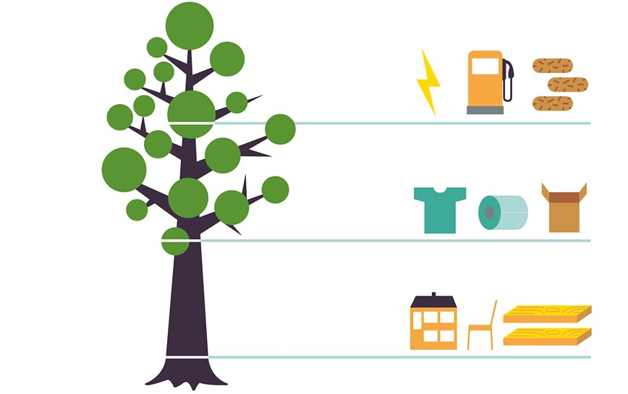
Wood
Natural renewable resource (sustainably sourced wood)
Each part of a tree can be used
Low impact production and processing cycle
Can be recycled into numerous new products and formats and, at the end of its useful life, it can be used as a renewable, carbon neutral energy source
Timber is increasingly proven as one of the prime materials on which to base bioeconomic and circular economic models
Notes:
Focus on WOOD sector →
Well suited to be a key player in a circular and biobased economy
Not focus on sustainable forest management or paper industry

Slide 4
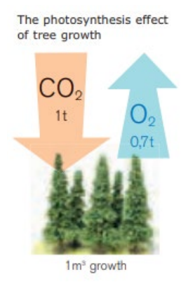
Wood
“Wood a key carbon store”
Each 1m³ of wood grown by a tree holds 0.9 tonnes of CO2 ‘sequestered’ from the atmosphere
At the same time wood products save on man-made emissions. They are substituting more energy intensive materials and substances, including fossil fuels in energy generation, steel, concrete, aluminium and plastic across a range of areas in manufacturing and construction.
Research and development are underway to enable them to replace more
Notes:
In terms of Climate change, wood is a key carbon store…

Slide 5
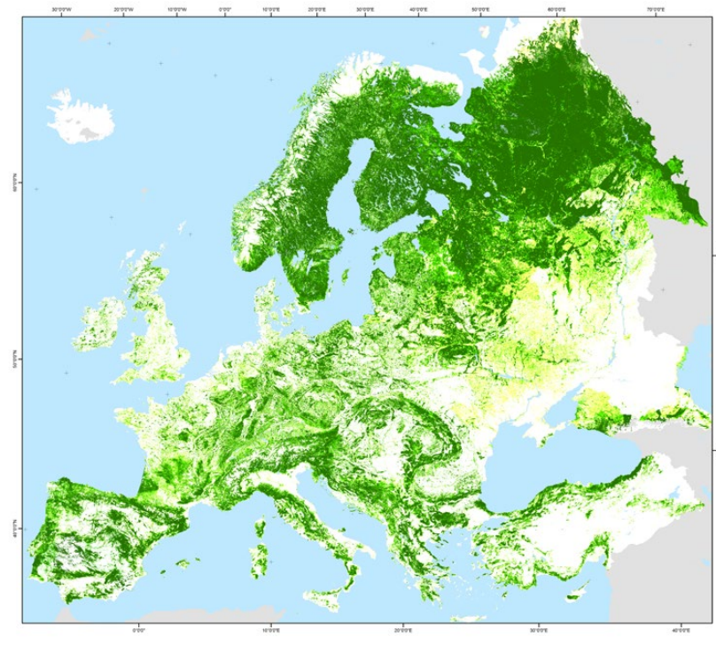
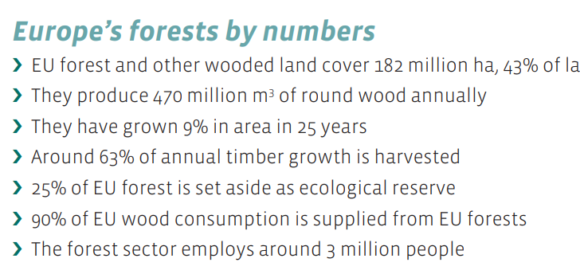
Current Situation
Forest Map of Europe 2011 (European Forest Institute)
Notes:
Sustainable forest management forms of course the foundation for this circular bio-economy to work

Slide 6
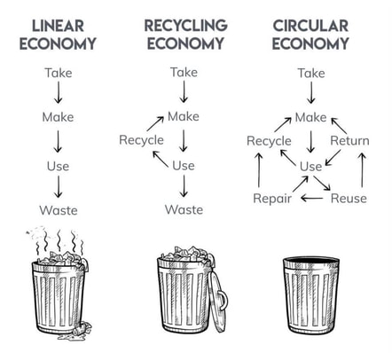
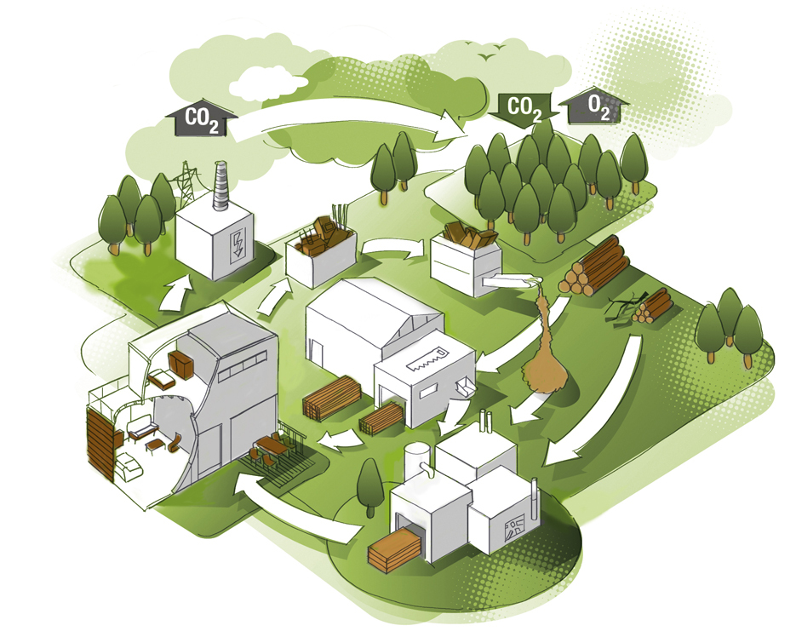
Current Situation
Wood value chain
/reuse
/reuse
Notes:
The Circular bio-economy is already embedded in the wood sector: waste /byproducts are reused in other wood-based products
When mature trees are harvested (and 80% of European timber production is softwood, such as pine, spruce, fir and Douglas fir and 20% hardwood, such as oak, beech, ash and birch), the large dimension logs go generally to mills for production of solid wood products, plywood and laminated veneer products. Smaller logs, plus other parts of the tree, go for pulp and paper manufacture and production of wood-based panel products, such as MDF, OSB, and particleboard. Their raw material is additionally supplemented with dust and chips from sawmills and post-consumer waste wood from further up the timber cascade. A proportion of residue from the harvest process also goes straight for wood-fuel, or applications such as animal bedding.
Pellets en paper industry

Slide 7
Waste types
Primary wood waste
Post-consumer wood waste
Waste from wood processing companies (sawmills, carpenters, furniture producers, etc.)
Waste from finished wooden products (households and industry)
A
Untreated wood waste
e.g. Pallets, crates, blocks, mill cuttings/dust
B
Non-contaminated Treated wood waste
e.g. wood-based panels, painted, coated, varnished wood
C
Contaminated Treated wood waste
e.g. train sleepers, chemically treated wood
Notes:
C-wood can not be reused or recycled and is therefore always directed towards energy recovery
Belgium: A wood may not be directed to E-recovery, unless by businesses for internal use only

Slide 8
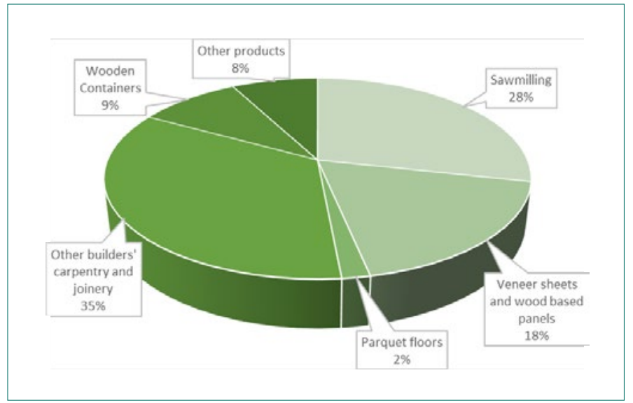
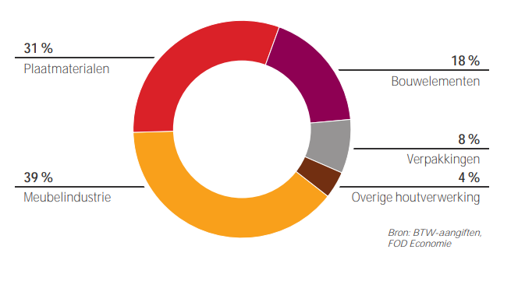
Wood working subsectors:
Wood applications Belgium 2020
(revenue based)
Relative importance of wood working subsectors,
EU28 2016. (Eurostat)
Remark: sector waste >90% = wood waste

Slide 9
Sawmills
Wood sources: tree trunks (softwood & hardwood)
Applications: solid wood products
  Construction timber
  Flooring
  Furniture
  Packaging
  Veneer
  Internal and external usage energy/heat recovery
  Bedding for animals
  Wood-based panel production
  Mulch & compost, soil improver
  Pellet production
Wood waste: shavings, wood dust, cutting waste, bark

Slide 10
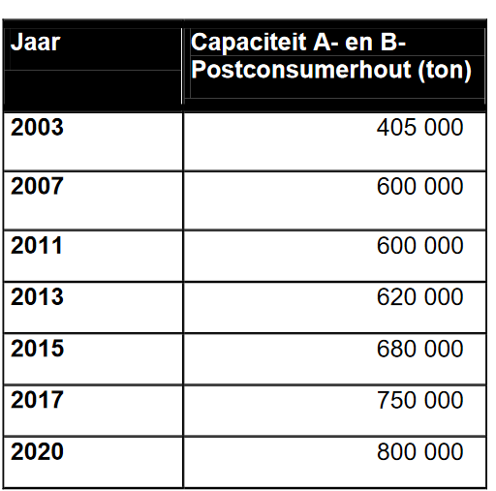
Wood-based panel production
Wood sources:
  Roundwood not suited for sawmilling
  Wood waste from sawmills and wood processing
  Post-consumer waste (A & B)
Evolution of usage of postconsumer waste by Flemish chipboard producers

Slide 11
Wood-based panel production
Wood sources: roundwood not suited for sawmilling, residue from sawmills and wood processing, post-consumer waste (A/B)
Applications: Products: chipboards, OSB, fibreboards (MDF, harboard, softboard), plywood
  Construction
  Siding & Flooring
  Furniture
  Packaging
  Internal reuse
  Internal usage energy/heat recovery
Wood waste: bark, cutting waste, wood dust, non-usable leftovers

Slide 12
Construction & Furniture (>70% of all wood products in EU)
Wood sources: solid wood, wood-based panels
Construction Products: doors, windows, floors, (lamellated) trusses, timberframes, etc.
Furniture Products: kitchens, bathrooms, dining rooms, bedrooms, office, seats, etc.
  Internal and external usage energy/heat recovery
  Post-consumer waste
Wood waste: cutting waste, wood dust

Slide 13
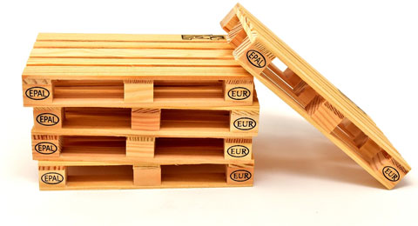
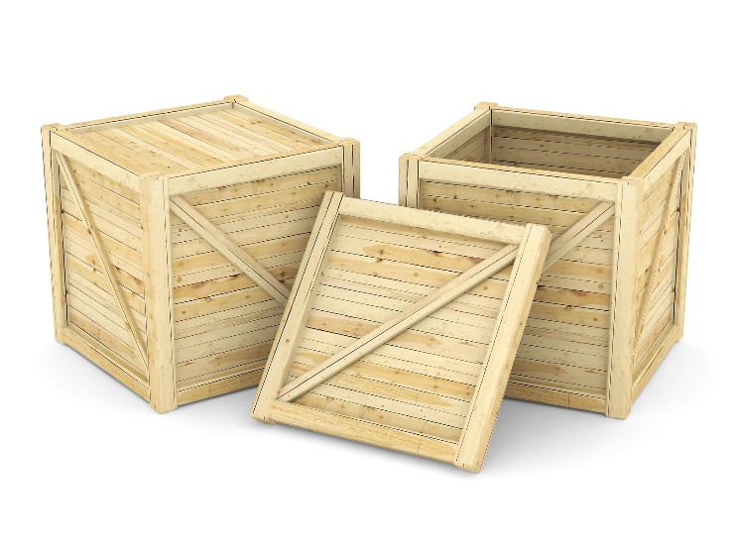
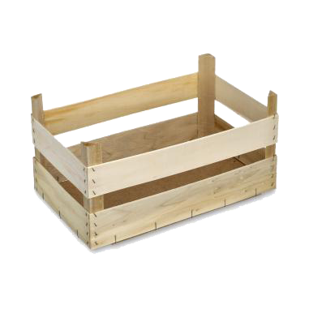
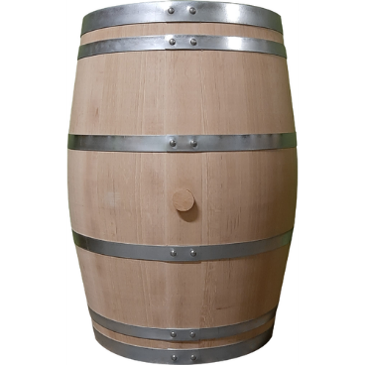
Packaging
Wood sources: solid wood, wood-based panels (+ G-blocks)
Applications:
  Pallets
  Crates
  Barrels
Wood waste: cutting waste, wood dust
  Internal and external usage energy/heat recovery
  Post-consumer waste

Slide 14
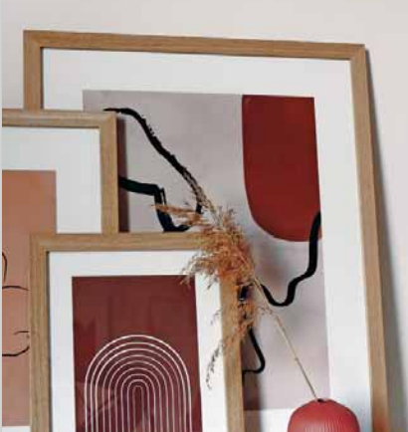
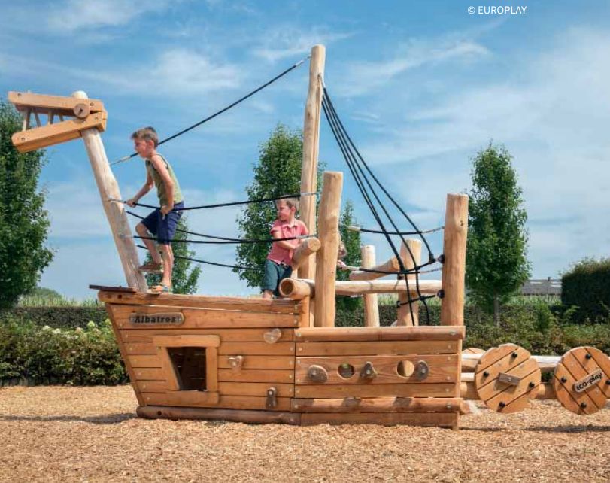
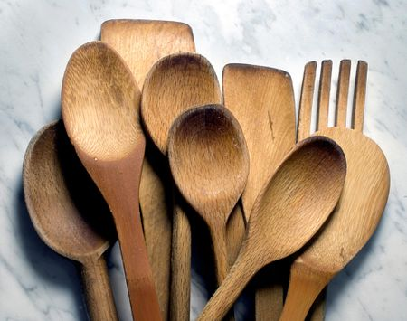
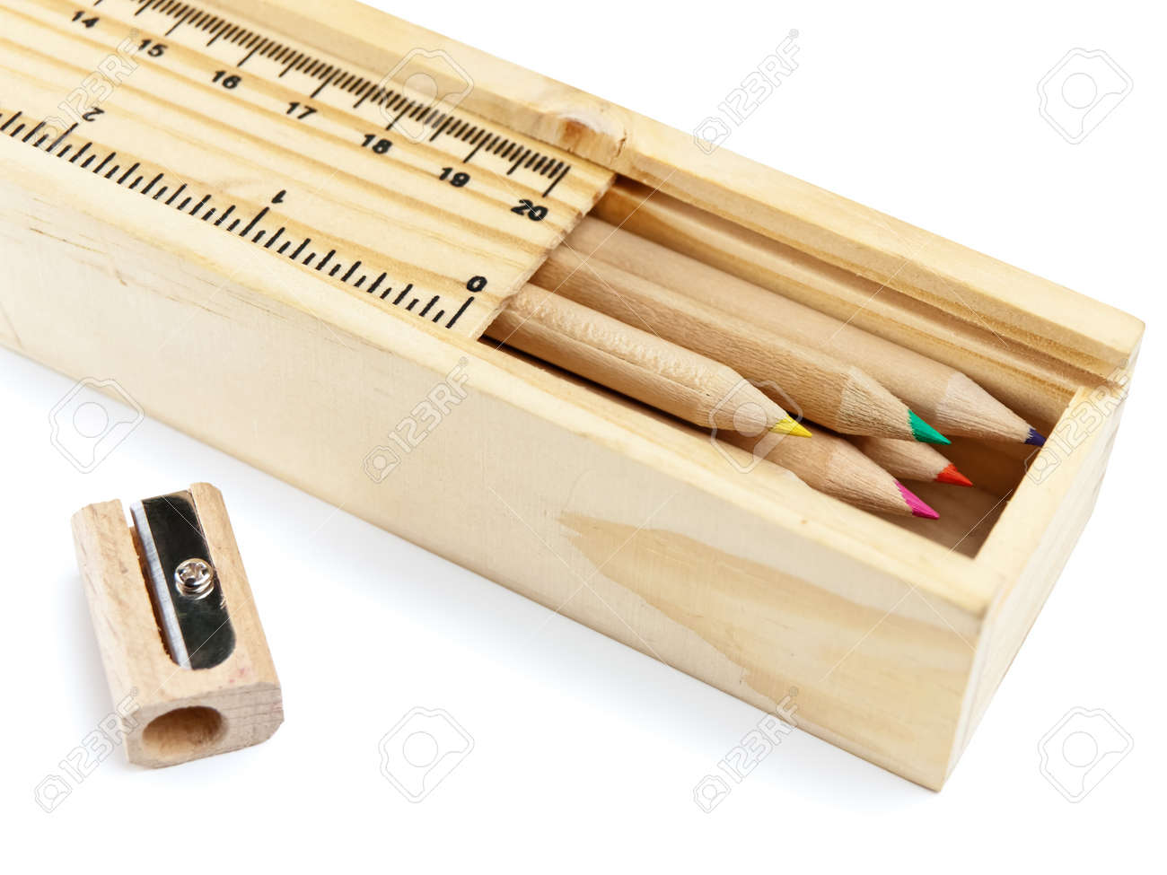
Other wood based products
Wood sources: solid wood, wood-based panels
Applications:
  Frames
  Music instruments
  Playground equipment
  Utensils, etc.
Wood waste: cutting waste, wood dust
  Internal and external usage energy/heat recovery
  Post-consumer waste

Slide 15
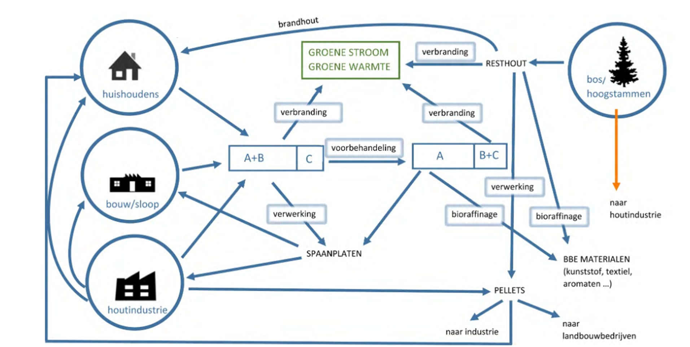
Situation in Flanders
Cycle of wood sidestreams in Flanders (OVAM, 2014)

Slide 16
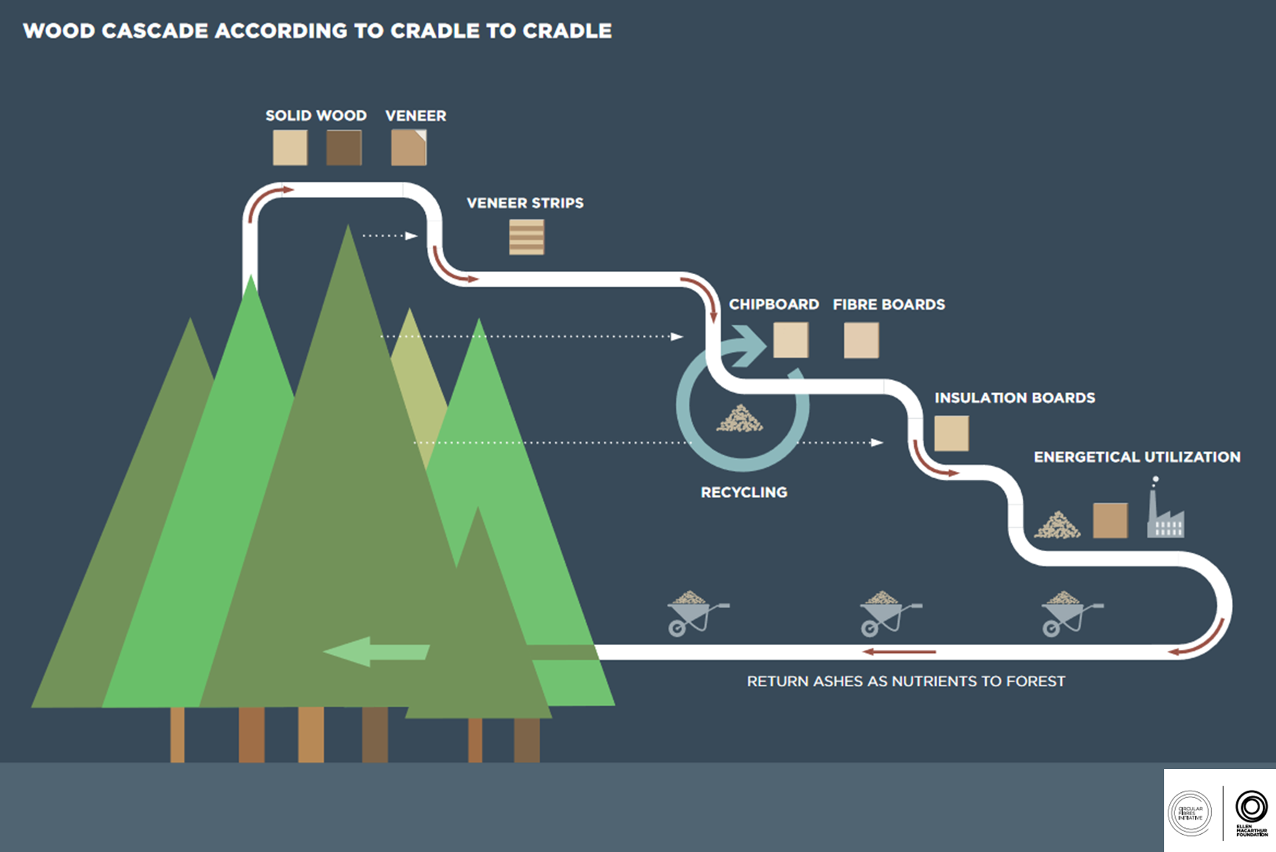
Cascading use of wood material
Keep the wood resource in the value chain as long as possible, not only to preserve the limited resource, but also to keep the CO₂ sequestered.
In 2016 in EU more than the 50% the overall potential of post-consumer wood was recovered.
Notes:
A lot of innovation efforts already done to increase the amount of post-consumer waste that stays in the loop, reuse, recycle, etc
Have become more efficient over time
In last decade % grown to more than 50%
To keep the wood fibers as long as possible in the value chain before at end of life burn it for energy recovery → keeps the resources in the loop + also keeps the co2 sequestered
Still room or significant improvement towards circularity in the sector

Slide 17
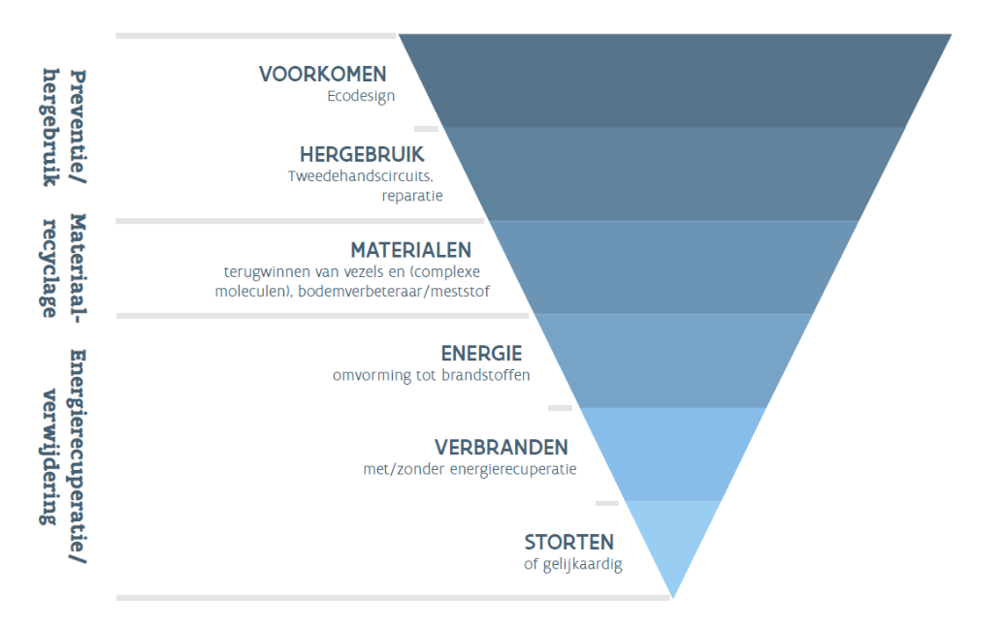
Keep wood in the value chain
Prevent loss of wood by designing materials/buildings that:
can last longer and are easier to maintain
are easier to reuse/repair
(e.g. modular, deconstructable)
Notes:
How:
1.
Design to reduce and further optimize wood usage
Decrease loss of reusable wood by better design/architecture, collection and sorting during demolition, material hubs, etc.
Innovate to better collect sort the B waste
New applications of wood and wood fibers, chemicals
Increased use in construction

Slide 18
Keep wood in the value chain
stimulate Reuse of wooden products by:
Promoting 2nd hand use - thrift stores
Promoting repair & refurbishment
Reusing (modular) furniture parts into new furniture or deco.
Promoting the remanufacturing or repurposing of wooden construction materials
Improving selective collection and pre-sorting of reusable wood (e.g. demolition)
Notes:
How:
1.
Design to reduce and further optimize wood usage
Decrease loss of reusable wood by better design/architecture, collection and sorting during demolition, material hubs, etc.
Innovate to better collect sort the B waste
New applications of wood and wood fibers, chemicals
Increased use in construction

Slide 19
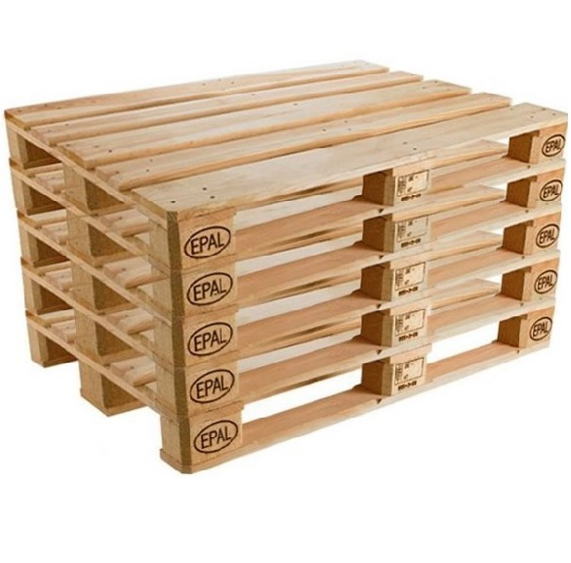
Examples from EMR
Herso (https://herso.nl/)
Europallet system (https://www.epal-pallets.org/eu-de/)
Material hubs → Leuven (https://materialenbankleuven.be/)

Slide 20
Keep wood in the value chain
Increase the Recycling options by:
Maximizing the separate collection of A and B type post-consumer waste
Optimizing the after-sorting of B wood to separate recyclable from non-recyclable material
(Further) increase the usage of B wood in panel applications
(Further) develop new technologies and new applications to increase recyclable B fraction (e.g. chemical recycling of molecules)
Notes:
How:
1.
Design to reduce and further optimize wood usage
Decrease loss of reusable wood by better design/architecture, collection and sorting during demolition, material hubs, etc.
Innovate to better collect sort the B waste
New applications of wood and wood fibers, chemicals
Increased use in construction

Slide 21
Examples from EMR
Unilin (https://www.unilinpanels.com/en-gb)
G-blocks (http://www.g-bloc.com/en)
Act & Sorb (https://www.actandsorb.com/)
Chemical recycling – Biorefinery projects:
  lignovalue (https://www.agro-chemistry.com/news/lignovalue-pilot-ready-to-be-built/)
  Torero (https://www.torero.eu/)

Slide 22
Keep wood in the value chain
Energy recovery:
Minimize the use of reusable or recyclable wood materials for energy recovery → only use as last resort for non-recyclable wood waste
Notes:
How:
1.
Design to reduce and further optimize wood usage
Decrease loss of reusable wood by better design/architecture, collection and sorting during demolition, material hubs, etc.
Innovate to better collect sort the B waste
New applications of wood and wood fibers, chemicals
Increased use in construction

Slide 23
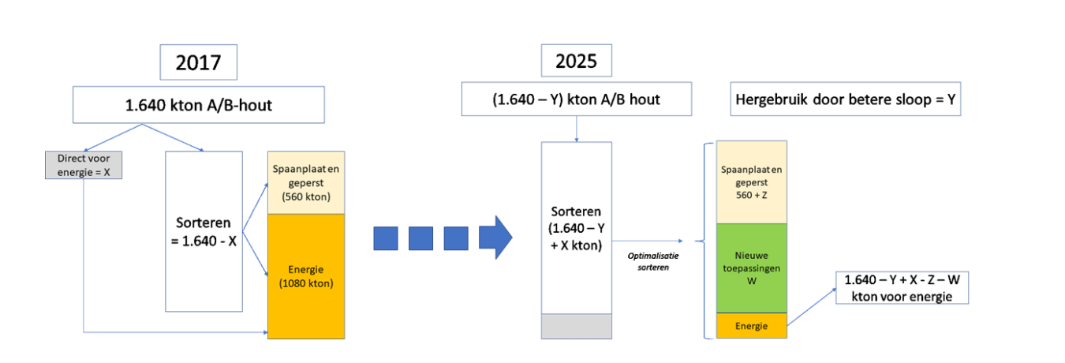
Obstacles to overcome
Lack of selective demolition – in general, all ends up in 1 skip
Current collection mostly A+B together @collection centers
Significant amounts of non-sorted A/B waste are immediately directed towards energy recovery
Technological difficulties in after-sorting and cleaning B-type materials due to mixed chemical and fysical properties and the complexity (e.g. A – B attached together)
        Many different types of glues, additives, paints & coatings, protective foils, etc. are used in the wood-panel industry
ambitions
post-consumer wood waste chain in the Netherlands in 2017 (Gemax bv)
Notes:
Similar situation in Belgium ~1100 kton →although >50% recycled already

Slide 24
Future ambitions – Action plans in Belgium and the Netherlands
(2021-2025) (based on reports from Rijkswaterstaat and OVAM)
Improve demolition with reuse and recycling in mind
Post-consumer waste needs to be sorted before possible application in energy recovery
Increase the percentage of recycled wood in wood-panel production (FL: minimum 85% by 2025)
Develop new applications to recycle more post-consumer wood waste, preferably applications that ensure longterm carbon storage (e.g. G-blocks, chemical recycling)
By 2030: an additional 50% of recyclable wood material is actually recycled

Slide 25
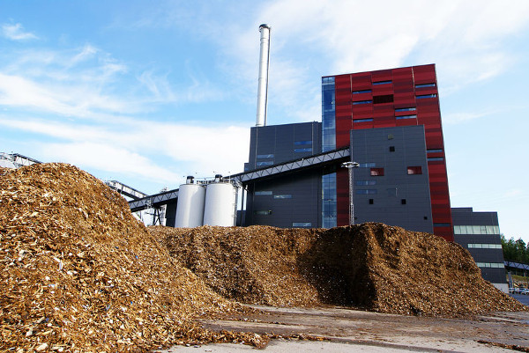
Some remarks & questions:
Prices of solid wood are rising → will stimulate reuse and innovation/investments to achieve this
Building with wood is on the rise → positive impact towards long-term carbon capture
To reach their renewable energy goals many governments (including NL, BE, DE) have invested in more biomass plants to expand their capacity to burn biomass for renewable energy.
What impact will this have on the sector and on wood waste supply/demand ?

Slide 26
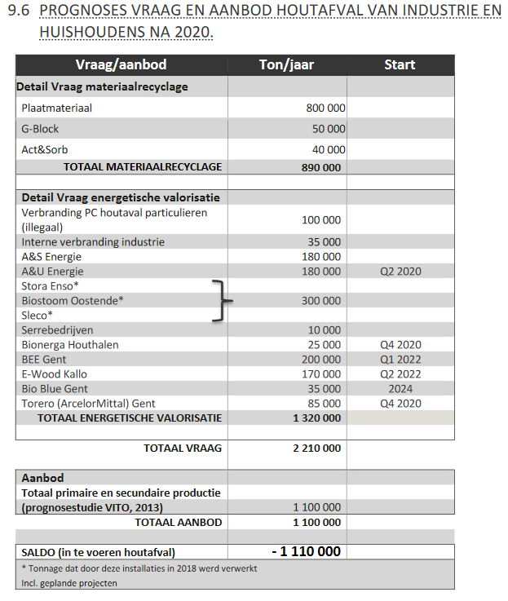
Some remarks & questions :
Prognosis of supply and demand of post-consumer wood waste in Flanders after 2020 (OVAM)
Biomass plants are heavily subsidized
Demand >>> supply
?
Competition for post-consumer wood waste?
Undermine efforts/investments to increase sorting towards recycling?
Pressure on innovation/investments towards new (chemical) recycling applications?
2015
Supply > demand
Notes:
Import needed from France, but…
In Flanders → only restricted to non-recyclable wood → but how to manage this, check this? What are the criteria?
In NL not restricted → A-wood aloud up to 15% in biomass plants, currently ~5%
How to harmonize both ambitions/goals? Can the goals of a circular economy in the wood sector be harmonized with the goals for renewable energy production?
Seems counterproductive? Counterintuitive to “burning as a last resort”

Slide 27
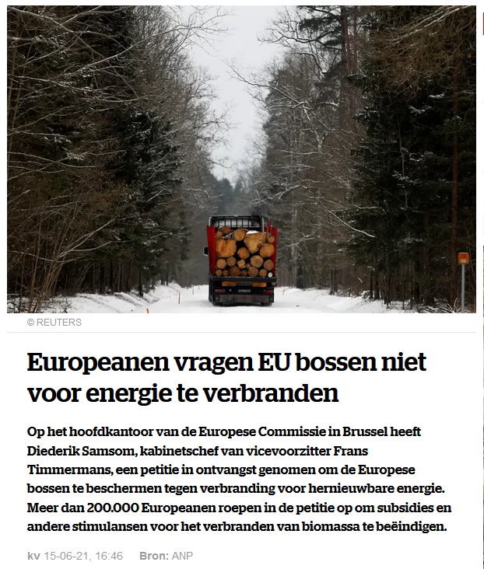
Some remarks & questions:

Slide 28
Want to know more? Want to get inspired?
Inspiration – how to get started
Belgium: Fedustria (https://www.fedustria.be/); Wood.be (https://www.wood.be/); OVAM (https://www.ovam.be/houtafval); woodfactory (https://www.woodfactory.be/)
Netherlands: Centrum Hout (https://www.centrumhout.nl/); http://www.bosenhoutcijfers.nl/bos-en-houtsector/de-sector/
EU: European Woodworking Industry Confederation | CEI-Bois | Belgium
Literature – reports:
EU (2020), Mededeling “Een nieuw actieplan voor een circulaire economie -Voor een schoner en concurrerender Europa”, COM(2020) 98 final, Brussel, 11.3.2020.
EU Wood – Building the Bioeconomy (https://issuu.com/fedustriapub/docs/wood-building-the-bioeconomy-final-version-22.10.2)
VITO: https://emis.vito.be/nl/bbt/publicaties/bbtbref-en-andere-publicaties/houtverwerkende-nijverheid
OVAM reports: https://www.ovam.be/sites/default/files/atoms/files/Actieplan%20voedselverlies%20en%20biomassa%28rest%29stromen%20circulair%202021-2025.pdf; https://www.ovam.be/sites/default/files/atoms/files/Voortgangsrapportage_actieplan_duurzaam_beheer_van_biomassareststromen_2015-2020.pdf
Rijkswaterstaat (NL): https://www.afvalcirculair.nl/onderwerpen/linkportaal/publicaties/downloads/downloads-diverse/hergebruik-recycling-afvalhout-plan-aanpak/
Contact: Tom Janssen - Business Developer @UCLL; Tom.Janssen@ucll.be; 0491/411 548

Slide 29
Some inspirational examples from the Euregion:

